Slide 1




Azure Machine Learning
Jay Liu jayli@Microsoft.com Cloud Solution Architect
Data, AI and Advanced Analytics

Slide 2
Azure Data Platform
Data Collection | Data Processing | Data Storage | Data Analysis | Presentation
Azure Data Factory | Azure Data Factory | SQL Database | Azure Machine Learning | Power BI
Azure IoT | HDInsight | Table/Blob/File/ Queue Storage | HDInsight | Power BI embedded
Import / Export Service | App Service Cloud Services | Cosmos DB | Azure Data Lake Analytics | SharePoint
SQL Tools | HPC / Batch | SQL DWH | Azure Analysis | App Service Cloud Services
Big Data Tools | Functions | Azure Data Lake Store | DSVM / DLVM | Azure Notebook
Azure Search | Stream Analytics | Blockchain (Bletchley ) | Cognitive Services | Excel
Backup/Restore | Azure Data Lake Analytics | Azure DB for MySQL & PostgreSQL | Stream Analytics | QlikView / Tableau
Other Tools (AzCopy) | Azure Database for MySQL / PostgreSQL | VM + SQL Server | Azure Databricks | SQL / VM (SS*S)

Slide 3
The Context
Deployment to multiple targets
Help with ease of data preparation
Automated Machine Learning
Distributed Training
Support both for Web Service and Batch modes
Strong support for Spark (Databricks)
Support for more training & deployment platforms
Better Integration with other services
No Need to have a pre-defined GUI Interface
End-to-End Lifecycle and processes
Open to frameworks and tools
Support Deep Learning frameworks
Help with Environment isolations
Better management of models & experiments
Especially on Tracking and Monitoring

Slide 4
Azure offers a comprehensive AI/ML platform that meets—and exceeds—requirements

Slide 5

Azure Machine Learning Platform
Bot Framework / services
Cognitive Services
Cortana and Other AI
Solutions (Graph, TSI, …)
Azure Databricks
AML Libraries for Spark
Jupyter Notebook & Azure Notebook
AML Workbench
AML Experimentation
AML Model Management
CNTK
VSTS
with TDSP
ML.NET
R & RStudio
Azure ML Studio
VS Code and Tools for AI Extensions
COSMOS DB
HDI
DSVM
/ DLVM
Batch / HPC
AKS / ACI
Machine Learning Server
Edge
Azure Cray
CPU, FPGA, GPU, IoT
Azure Data Lake / Azure Storage
Q# and
QSDK

Slide 6










Machine Learning
Typical E2E Process
Prepare Experiment
Deploy
…
…
Orchestrate

Slide 7

DevOps loop for data science
Prepare
Train &
Test Model
TEST
DEVELOPMENT
…
Register and Manage Model
STAGING
Build model (your favorite IDE)
Prepare Data
PORDUCTION
Deploy Service Monitor Model
Build Image

Slide 8
What is Azure Machine Learning service?
Set of Azure Cloud Services
Python SDK
That enables you to:
Prepare Data
Build Models
Train Models
Manage Models
Track Experiments
Deploy Models

Slide 9
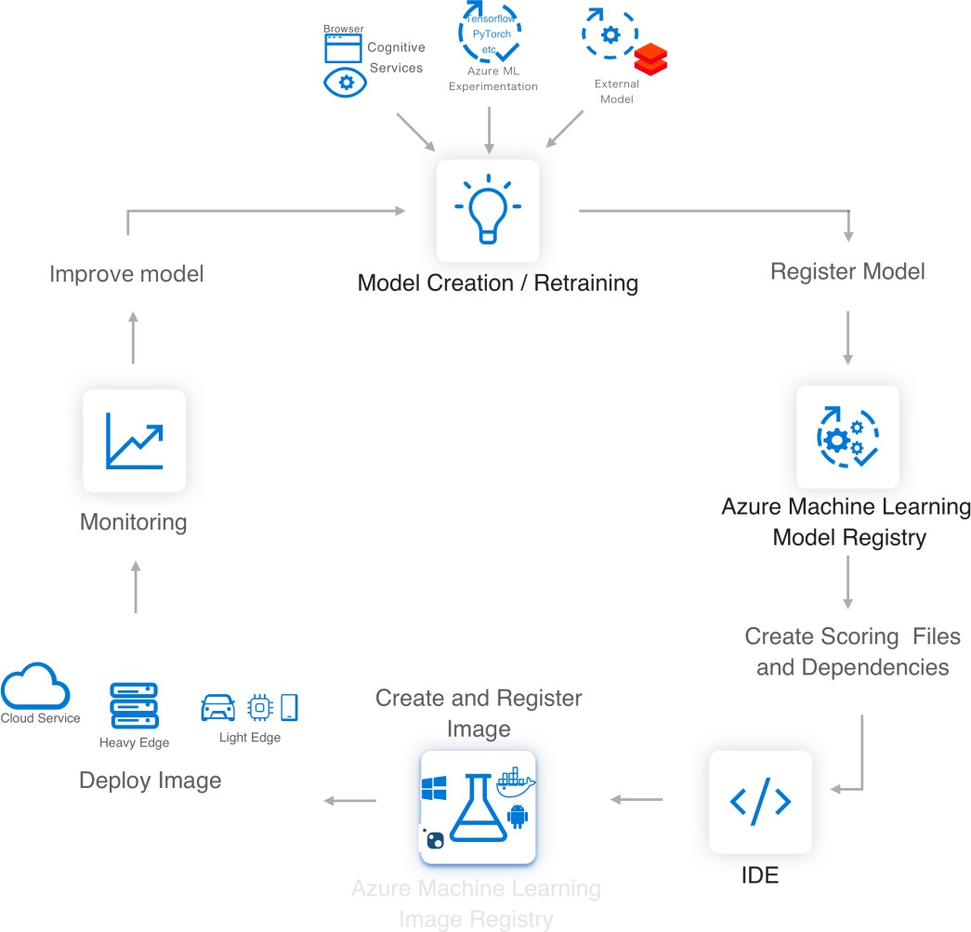


Azure ML service
Lets you easily implement this AI/ML Lifecycle
Workflow Steps
Azure Machine Learning

Slide 10
Data Preparation
Multiple Data Sources
SQL and NoSQL databases, file systems, network attached storage and cloud stores (such as Azure Blob Storage) and HDFS.
Multiple Formats
Binary, text, CSV, TS, ARFF, etc. and auto detect file types.
Cleansing
Detect and fix NULL values, outliers, out-of-range values, duplicate rows.
Transformation / Filtering
General data transformation (transforming types) and ML-specific transformations (indexing, encoding, assembling into vectors, normalizing the vectors, binning, normalization and categorization).
Intelligent time-saving transformations
Derive column by example, fuzzy grouping, auto split columns by example, impute missing values.
Custom Python Transforms
Such as new script column, new script filter, transformation partition

Slide 11
Model Building (DEV)
Choice of algorithms
Choice of language
Python
Choice of development tools
Browser-based, REPL-oriented, notebooks such as Jupyter, PyCharm and Spark Notebooks.
Desktop IDEs such as Visual Studio and R-Studio for R development.
Local Testing
To verify correctness before submitting to a more powerful
(and expensive) training infrastructure.

Slide 12

Model Training and Testing
Powerful Compute Environment
Choices include scale-up VMs, auto-scaling scale-out clusters
Preconfigured
The compute environments are pre-setup with all the correct versions ML frameworks, libraries, executables and container images.
Job Management
Data scientists are able to easily start, stop, monitor and manage Jobs.
Automated Model and Parameter Selection
Solutions are automatically select the best algorithms, and the corresponding best hyperparameters, for the desired outcome.

Slide 13
Model Registration and Management
Containerization
Automatically convert models to Docker containers so that they can be deployed into an execution environment.
Versioning
Assign versions numbers to models, to track changes over time, to identify and retrieve a specific version for deployment, for A/B testing, rolling back changes etc.
Model Repository
For storing and sharing models, to enable integration into CI/CD pipelines.
Track Experiments
For auditing, see changes over time and enable collaboration between team members.

Slide 14

Model Deployment
Choice of Deployment Environments
Single VM, Cluster of VMs, Spark Clusters, Hadoop Clusters, In the cloud, On-premises
Edge Deployment
To enable predictions close to the event source-for quicker response and avoid unnecessary data transfer.
Security
Your data and model is secured. Even when deployed at the edge, the e2e security is maintained.
Monitoring
Monitor the status, performance and security.

Slide 15






Azure Machine Learning: Technical Details

Slide 16








Azure ML service
Key Artifacts
Workspace

Slide 17
Azure ML service Artifact
Workspace
The workspace is the top-level resource for the Azure Machine Learning service. It provides a centralized place to work with all the artifacts you create when using Azure Machine Learning service.
The workspace keeps a list of compute targets that can be used to train your model. It also keeps a
history of the training runs, including logs, metrics, output, and a snapshot of your scripts.
Models are registered with the workspace.
You can create multiple workspaces, and each workspace can be shared by multiple people. When you create a new workspace, it automatically creates these Azure resources:
Azure Container Registry - Registers docker containers that are used during training and when deploying a model.
Azure Storage - Used as the default datastore for the workspace.
Azure Application Insights - Stores monitoring information about your model service.
Azure Key Vault - Stores secrets used by compute targets and other sensitive information needed by the workspace.

Slide 18
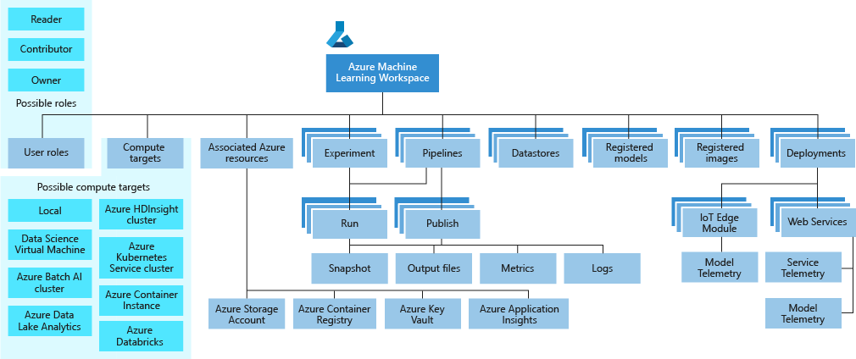
Azure ML service Workspace Taxonomy

Slide 19



Azure ML service Artifacts
Models and Model Registry
Model
Model Registry

Slide 20

Azure ML Artifacts
Runs and Experiments
Experiment
Run
Run configuration

Slide 21





Azure ML service Artifacts
Image and Registry
Image contains
Image Registry
Two types of images

Slide 22
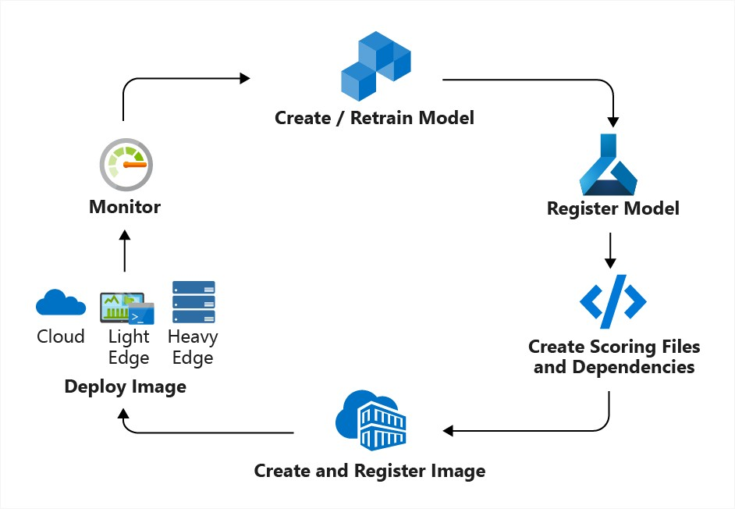
Azure ML Concept
Model Management
Model Management in Azure ML usually involves these four steps
Step 1:
Step 2:
Step 3:
Step 4:

Slide 23





Azure ML Artifact
Deployment
Deployment is an instantiation of an image
Web service
IoT Module

Slide 24
Azure ML Artifact
Datastore

Slide 25
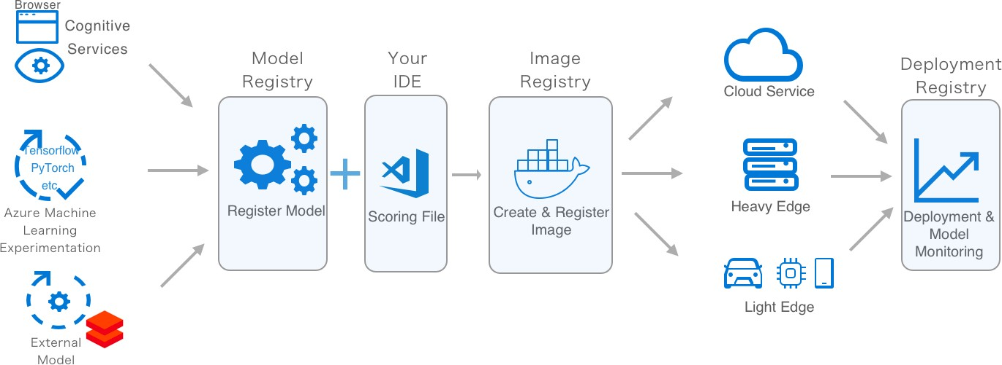

Azure ML: How to deploy models at scale

Slide 26
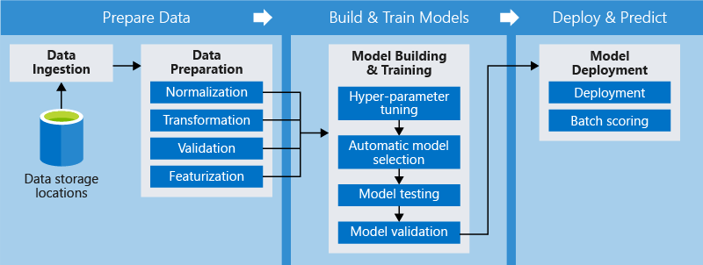
Azure ML Artifact
Pipeline
A step is a computational unit in the pipeline.
How pipelines help?
✓
✓
✓
✓

Slide 27

Azure ML Pipeline
Python SDK
The Azure Machine Learning SDK offers imperative constructs for sequencing and parallelizing the steps in your pipelines when no data dependency is present.
Using declarative data dependencies, you can optimize your tasks.
The SDK includes a framework of pre-built modules for common tasks
such as data transfer and model publishing.
The framework can be extended to model your own conventions by implementing custom steps that are reusable across pipelines.
Compute targets and storage resources can also be managed directly from the SDK.
Pipelines can be saved as templates and can be deployed to a REST endpoint so you can schedule batch-scoring or retraining jobs

Slide 28


Azure ML Pipelines
Advantages
Advantage | Description

Slide 29
Azure ML Artifact
Compute Target
Currently supported compute targets
Compute Target | Training | Deployment
Local Computer | ✓
A Linux VM in Azure (such as the Data Science Virtual Machine) | ✓
Azure ML Compute | ✓
Azure Databricks | ✓
Azure Data Lake Analytics | ✓
Apache Spark for HDInsight | ✓
Azure Container Instance |  | ✓
Azure Kubernetes Service |  | ✓
Azure IoT Edge |  | ✓
Field-programmable gate array (FPGA) |  | ✓

Slide 30
Azure ML
Currently Supported Compute Targets
Compute target | GPU acceleration | Hyperdrive | Automated model selection | Can be used in pipelines
Local computer | Maybe |  | ✓
Data Science Virtual Machine (DSVM) | ✓ | ✓ | ✓ | ✓
Azure ML compute | ✓ | ✓ | ✓ | ✓
Azure Databricks | ✓ |  | ✓ | ✓
Azure Data Lake Analytics |  |  |  | ✓
Azure HDInsight |  |  |  | ✓
https://docs.microsoft.com/en-us/azure/machine-learning/service/how-to-set-up-training-targets#supported-compute-targets

Slide 31



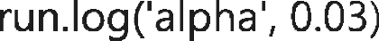







Azure Machine Learning
Track experiments and training metrics

Slide 32
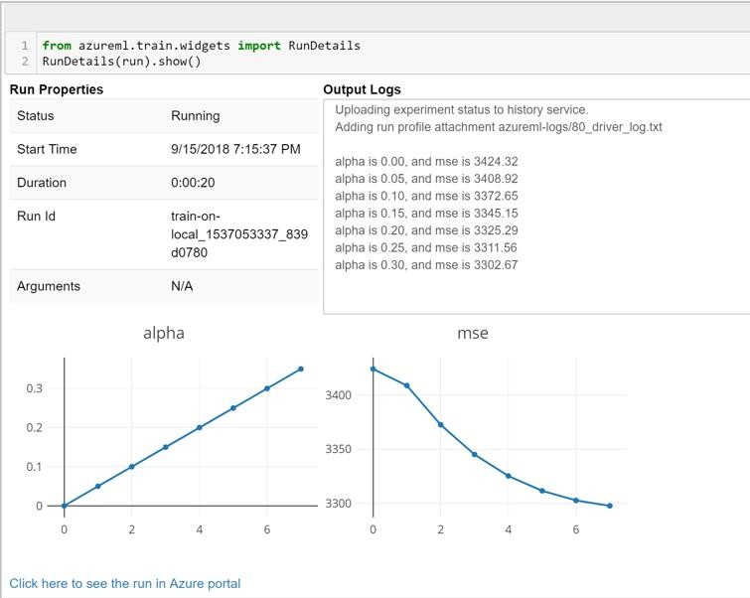








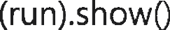
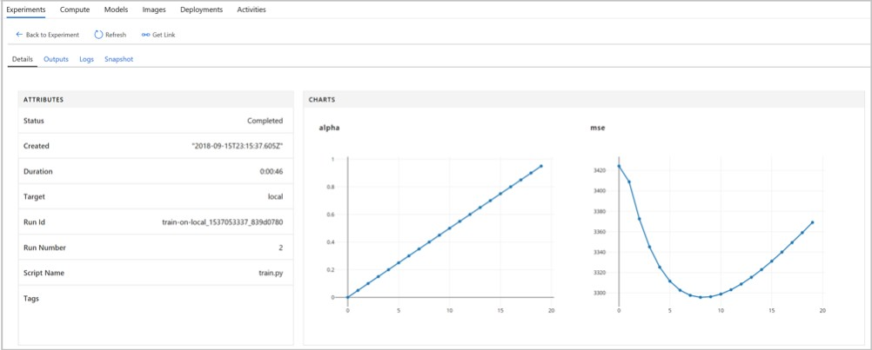




Azure Machine Learning
Track experiments and training metrics

Slide 33
Azure Machine Learning
Data Wrangler – DataPrep SDK: https://docs.microsoft.com/en-us/python/api/azureml-dataprep/?view=azure-dataprep-py
Automatic file type detection.
Load from many file types with parsing parameter inference (encoding, separator, headers).
Type-conversion using inference during file loading
Connection support for MS SQL Server and Azure Data Lake Storage
Add column using an expression
Impute missing values
Derive column by example
Filtering
Custom Python transforms
Scale through streaming – instead of loading all data in memory
Summary statistics
Intelligent time-saving transformations:
Fuzzy grouping
Derived column by example
Automatic split columns by example
Impute missing values
Automatic join
Cross-platform functionality with a single code artifact. The SDK also allows for dataflow objects to be serialized and opened in any Python environment.

Slide 34
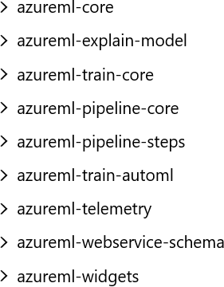


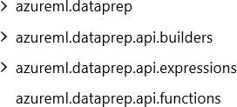
Azure Machine Learning
Azure Machine Learning SDK
pip install --upgrade azureml-sdk[notebooks,automl]
pip install azureml-monitoring
from azureml.monitoring import ModelDataCollector
pip install --upgrade azureml-dataprep
import azureml.dataprep as dprep

Slide 35
How to use the Azure Machine Learning service:
An example using the Python SDK

Slide 36
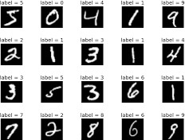

Setup for Code Example
This example trains a simple logistic regression using the MNIST dataset and scikit-learn with Azure Machine Learning service.
MNIST is a dataset consisting of 70,000 grayscale images.
Each image is a handwritten digit of 28x28 pixels, representing a number from 0 to 9.
The goal is to create a multi-class classifier to
identify the digit a given image represents.

Slide 37
Step 1 – Create a workspace
from azureml.core import Workspace
ws = Workspace.create(name='myworkspace',
subscription_id='<azure-subscription-id>', resource_group='myresourcegroup', create_resource_group=True,
location='eastus2' # or other supported Azure region
)
# see workspace details
ws.get_details()
Step 2 – Create an Experiment
experiment_name = ‘my-experiment-1'
from azureml.core import Experiment
exp = Experiment(workspace=ws, name=experiment_name)

Slide 38

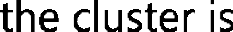




Step 3 – Create remote compute target
# choose a name for your cluster, specify min and max nodes compute_name = os.environ.get("BATCHAI_CLUSTER_NAME", "cpucluster") compute_min_nodes = os.environ.get("BATCHAI_CLUSTER_MIN_NODES", 0) compute_max_nodes = os.environ.get("BATCHAI_CLUSTER_MAX_NODES", 4)
# This example uses CPU VM. For using GPU VM, set SKU to STANDARD_NC6 vm_size = os.environ.get("BATCHAI_CLUSTER_SKU", "STANDARD_D2_V2")
provisioning_config = AmlCompute.provisioning_configuration(
vm_size = vm_size,
min_nodes = compute_min_nodes, max_nodes = compute_max_nodes)
# create the cluster
print(‘ creating a new compute target... ')
compute_target = ComputeTarget.create(ws, compute_name, provisioning_config)
# You can poll for a minimum number of nodes and for a specific timeout.
# if no min node count is provided it will use the scale settings for the cluster
compute_target.wait_for_completion(show_output=True,
min_node_count=None, timeout_in_minutes=20)

Slide 39
Step 4 – Upload data to the cloud
First load the compressed files into numpy arrays. Note the ‘load_data’ is a custom function that simply parses the
compressed files into numpy arrays.
# note that while loading, we are shrinking the intensity values (X) from 0-255 to 0-1 so that the model converge faster.
X_train = load_data('./data/train-images.gz', False) / 255.0 y_train = load_data('./data/train-labels.gz', True).reshape(-1)
X_test = load_data('./data/test-images.gz', False) / 255.0 y_test = load_data('./data/test-labels.gz', True).reshape(-1)
Now make the data accessible remotely by uploading that data from your local machine into Azure so it can be
accessed for remote training. The files are uploaded into a directory named mnist at the root of the datastore.
ds = ws.get_default_datastore()
print(ds.datastore_type, ds.account_name, ds.container_name)
ds.upload(src_dir='./data', target_path='mnist', overwrite=True, show_progress=True)
We now have everything you need to start training a model.

Slide 40
Step 5 – Train a local model
Train a simple logistic regression model using scikit-learn locally. This should take a minute or two.
%%time from sklearn.linear_model import LogisticRegression
clf = LogisticRegression()
clf.fit(X_train, y_train)
# Next, make predictions using the test set and calculate the accuracy y_hat = clf.predict(X_test)
print(np.average(y_hat == y_test))
You should see the local model accuracy displayed. [It should be a number like 0.915]

Slide 41
Step 6 – Train model on remote cluster
To submit a training job to a remote you have to perform the following tasks:
6.1: Create a directory
6.2: Create a training script
6.3: Create an estimator object
6.4: Submit the job
Step 6.1 – Create a directory
Create a directory to deliver the required code from your computer to the remote resource.
import os
script_folder = './sklearn-mnist' os.makedirs(script_folder, exist_ok=True)

Slide 42
Step 6.2 – Create a Training Script (1/2)
%%writefile $script_folder/train.py
# load train and test set into numpy arrays
# Note: we scale the pixel intensity values to 0-1 (by dividing it with 255.0) so the model can # converge faster.
# ‘data_folder’ variable holds the location of the data files (from datastore) Reg = 0.8 # regularization rate of the logistic regression model.
X_train | = | load_data(os.path.join(data_folder, | 'train-images.gz'), False) / 255.0
X_test | = | load_data(os.path.join(data_folder, | 'test-images.gz'), False) / 255.0
y_train | = | load_data(os.path.join(data_folder, | 'train-labels.gz'), True).reshape(-1)
y_test | = | load_data(os.path.join(data_folder, | 'test-labels.gz'), True).reshape(-1)
print(X_train.shape, y_train.shape, X_test.shape, y_test.shape, sep = '\n’)
# get hold of the current run run = Run.get_context()
#Train a logistic regression model with regularizaion rate of’ ‘reg’ clf = LogisticRegression(C=1.0/reg, random_state=42) clf.fit(X_train, y_train)

Slide 43
Step 6.2 – Create a Training Script (2/2)
print('Predict the test set’) y_hat = clf.predict(X_test)
# calculate accuracy on the prediction acc = np.average(y_hat == y_test)
print('Accuracy is', acc)
run.log('regularization rate', np.float(args.reg))
run.log('accuracy', np.float(acc)) os.makedirs('outputs', exist_ok=True)
# The training script saves the model into a directory named ‘outputs’. Note files saved in the
# outputs folder are automatically uploaded into experiment record. Anything written in this # directory is automatically uploaded into the workspace.
joblib.dump(value=clf, filename='outputs/sklearn_mnist_model.pkl')

Slide 44

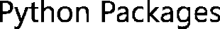
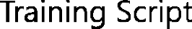




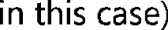
Step 6.3 – Create an Estimator
An estimator object is used to submit the run.
from azureml.train.estimator import Estimator
script_params = { '--data-folder': ds.as_mount(), '--regularization': 0.8 }
est = Estimator(source_directory=script_folder,
script_params=script_params, compute_target=compute_target,
entry_script='train.py’, conda_packages=['scikit-learn'])
Step 6.4 – Submit the job to the cluster for training
run = exp.submit(config=est)

Slide 45

What happens after you submit the job?
Image creation
A Docker image is created matching the Python environment specified by the estimator. The image is uploaded to the workspace. Image creation and uploading takes about 5 minutes.
This happens once for each Python environment since the container is cached for subsequent runs. During image creation, logs are streamed to the run history. You can monitor the image creation progress using these logs.
Scaling
If the remote cluster requires more nodes to execute the run than currently available, additional nodes are added automatically. Scaling typically takes about 5 minutes.
Running
In this stage, the necessary scripts and files are sent to the compute target, then data stores are mounted/copied, then the entry_script is run.
While the job is running, stdout and the ./logs
directory are streamed to the run history. You can monitor the run's progress using these logs.
Post-Processing
The ./outputs directory of the run is copied over to the run history in your workspace so you can access these results.

Slide 46
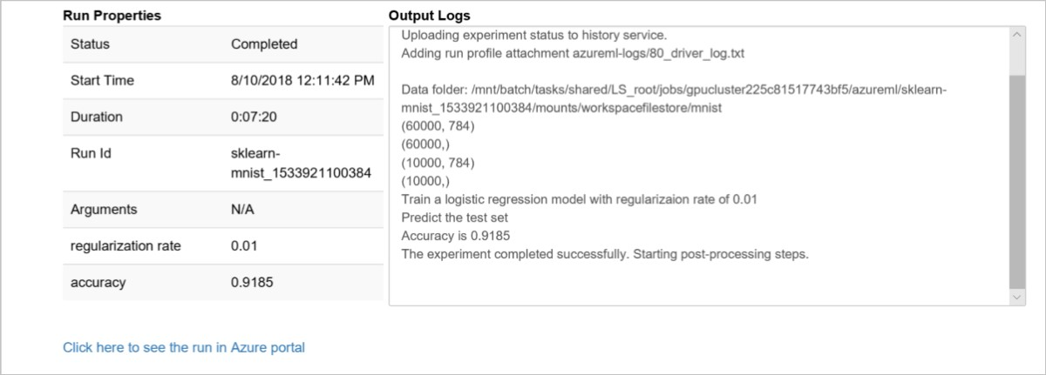
Step 7 – Monitor a run
You can watch the progress of the run with a Jupyter widget. The widget is asynchronous and provides live updates every 10-15 seconds until the job completes.
from azureml.widgets import RunDetails
RunDetails(run).show()
Here is a still snapshot of the widget shown at the end of training:

Slide 47

Step 8 – See the results
As model training and monitoring happen in the background. Wait until the model has completed training before running more code. Use wait_for_completion to show when the model training is complete
run.wait_for_completion(show_output=False)
# now there is a trained model on the remote cluster print(run.get_metrics())
{'regularization rate': 0.8, 'accuracy': 0.9204}

Slide 48
Step 9 – Register the model
Recall that the last step in the training script is:
joblib.dump(value=clf, filename='outputs/sklearn_mnist_model.pkl')
This wrote the file ‘outputs/sklearn_mnist_model.pkl’ in a directory named ‘outputs’ in the VM of the cluster where
the job is executed.
outputs is a special directory in that all content in this directory is automatically uploaded to your workspace.
This content appears in the run record in the experiment under your workspace.
Hence, the model file is now also available in your workspace.
# register the model in the workspace model = run.register_model (
model_name='sklearn_mnist’, model_path='outputs/sklearn_mnist_model.pkl’)
The model is now available to query, examine, or deploy

Slide 49
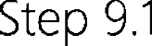

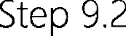
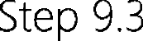

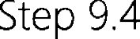

Step 9 – Deploy the Model

Slide 50



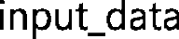

Step 9.1 – Create the scoring script
Create the scoring script, called score.py, used by the web service call to show how to use the model. It requires two functions – init() and run (input data)
from azureml.core.model import Model
def init():
global model
# retreive the path to the model file using the model name model_path = Model.get_model_path('sklearn_mnist’)
model = joblib.load(model_path)
def run(raw_data):
data = np.array(json.loads(raw_data)['data’]) # make prediction
y_hat = model.predict(data) return json.dumps(y_hat.tolist())

Slide 51
Step 9.2 – Create environment file
Create an environment file, called myenv.yml, that specifies all of the script's package dependencies. This file is used to ensure that all of those dependencies are installed in the Docker image. This example needs scikit-learn and azureml-sdk.
from azureml.core.conda_dependencies import CondaDependencies
myenv = CondaDependencies() myenv.add_conda_package("scikit-learn")
with open("myenv.yml","w") as f: f.write(myenv.serialize_to_string())
Step 9.3 – Create configuration file
Create a deployment configuration file and specify the number of CPUs and gigabyte of RAM needed for the ACI container. Here we will use the defaults (1 core and 1 gigabyte of RAM)
from azureml.core.webservice import AciWebservice
aciconfig = AciWebservice.deploy_configuration(cpu_cores=1, memory_gb=1,
tags={"data": "MNIST", "method" : "sklearn"},
description='Predict MNIST with sklearn')

Slide 52


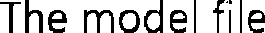
Step 9.4 – Deploy the model to ACI
%%time
from azureml.core.webservice import Webservice from azureml.core.image import ContainerImage
# configure the image
image_config = ContainerImage.image_configuration(
execution_script ="score.py", runtime ="python", conda_file ="myenv.yml")
service = Webservice.deploy_from_model(workspace=ws, name='sklearn-mnist-svc’,
deployment_config=aciconfig, models=[model], image_config=image_config)
service.wait_for_deployment(show_output=True)

Slide 53


Step 10 – Test the deployed model using the HTTP end point
Test the deployed model by sending images to be classified to the HTTP endpoint
import requests import json
# send a random row from the test set to score random_index = np.random.randint(0, len(X_test)-1)
input_data = "{\"data\": [" + str(list(X_test[random_index])) + "]}"
headers = {'Content-Type':'application/json’}
resp = requests.post(service.scoring_uri, input_data, headers=headers) print("POST to url", service.scoring_uri)
#print("input data:", input_data)
print("label:", y_test[random_index]) print("prediction:", resp.text)
https://github.com/Azure/MachineLearningNotebooks/tree/master/tutorials https://docs.microsoft.com/en-us/azure/machine-learning/service/tutorial-train-models-with-aml

Slide 54
Azure Automated Machine Learning ‘simplifies’ the creation and selection of the optimal model

Slide 55



Typical ‘manual’ approach to hyperparameter tuning
Dataset
Complex Tedious Repetitive
Time consuming Expensive
Model Training Infrastructure
Training Algorithm 1
Training Algorithm 2
Model 1
Model 2
Model 3
Model 4
yperparameter alues – config 1
H _{HH}
yperparameter alues – config 2
V _{V}
yperparameter
Values – config 3
Hyperparame
ter
Values – config 4

Slide 56
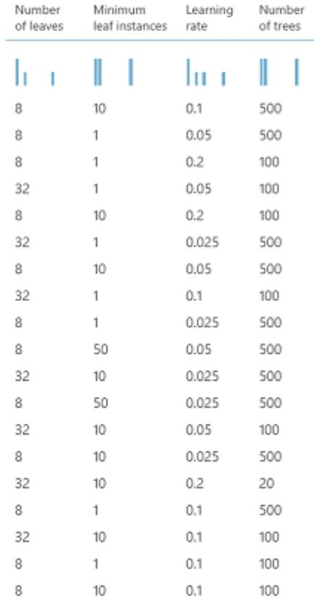
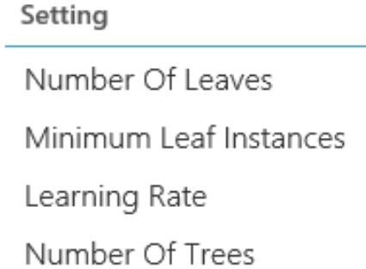
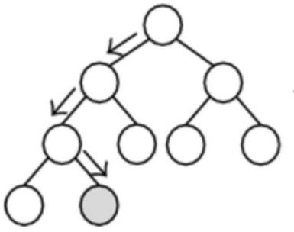
What are Hyperparameters?
Adjustable parameters that govern model training Chosen prior to training, stay constant during training Model performance heavily depends on hyperparameter

Slide 57

Challenges with Hyperparameter Selection
The search space to explore—i.e. evaluating all possible combinations—is huge.
Sparsity of good configurations.
Very few of all possible configurations are optimal.
Evaluating each configuration is resource and time consuming.
Time and resources are limited.

Slide 58


Azure Automated ML: Sampling to generate new runs
HyperDrive
Config1= {“learning_rate”: 0.2,
“num_layers”: 2, …}
{
Config2= {“learning_rate”: 0.5,
“num_layers”: 4, …}
“learning_rate”: uniform(0, 1),
“num_layers”: choice(2, 4, 8)
…
}
Config3= {“learning_rate”: 0.9,
“num_layers”: 8, …}
…
Supported sampling algorithms:
Grid Sampling Random Sampling Bayesian Optimization

Slide 59
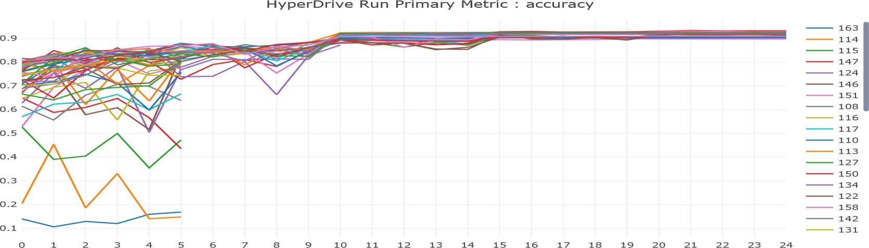

Azure Automated ML
HyperDrive
Evaluate training runs for
specified primary metric
Use resources to explore new configurations
Early terminate poor performing training runs. Early termination policies include:
Define the parameter search space
Specify a primary metric to optimize
Specify early termination criteria for poorly performing runs
Allocate resources for hyperparameter tuning
Launch an experiment with the above configuration
Visualize the training runs
Select the best performing configuration for your model

Slide 60
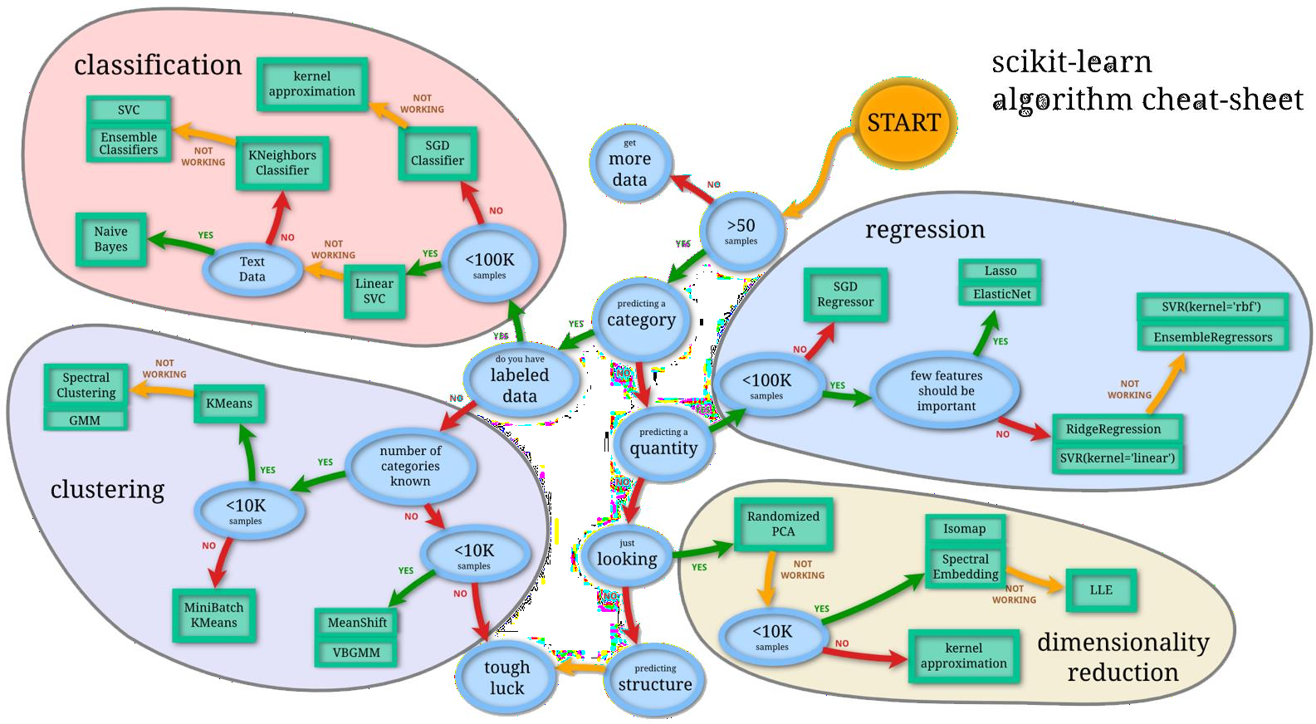
Complexity of Machine Learning
Source: http://scikit-learn.org/stable/tutorial/machine_learning_map/index.html

Slide 61
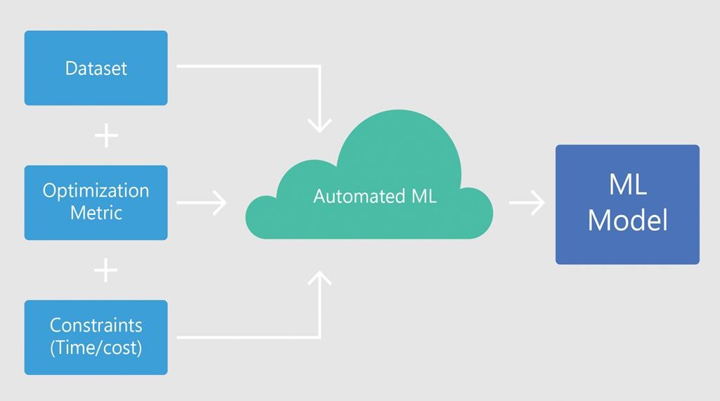

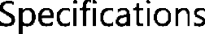




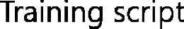

Azure Automated ML
Conceptual Overview

Slide 62
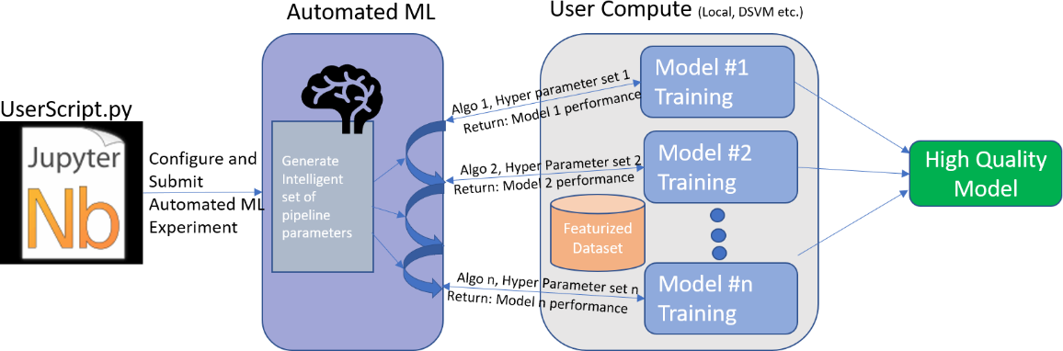
Azure Automated ML
How It Works
During training, the Azure Machine Learning service creates a number of pipelines that try different algorithms and parameters. It will stop once it hits the iteration limit you provide, or when it reaches the target value for the metric you specify.

Slide 63

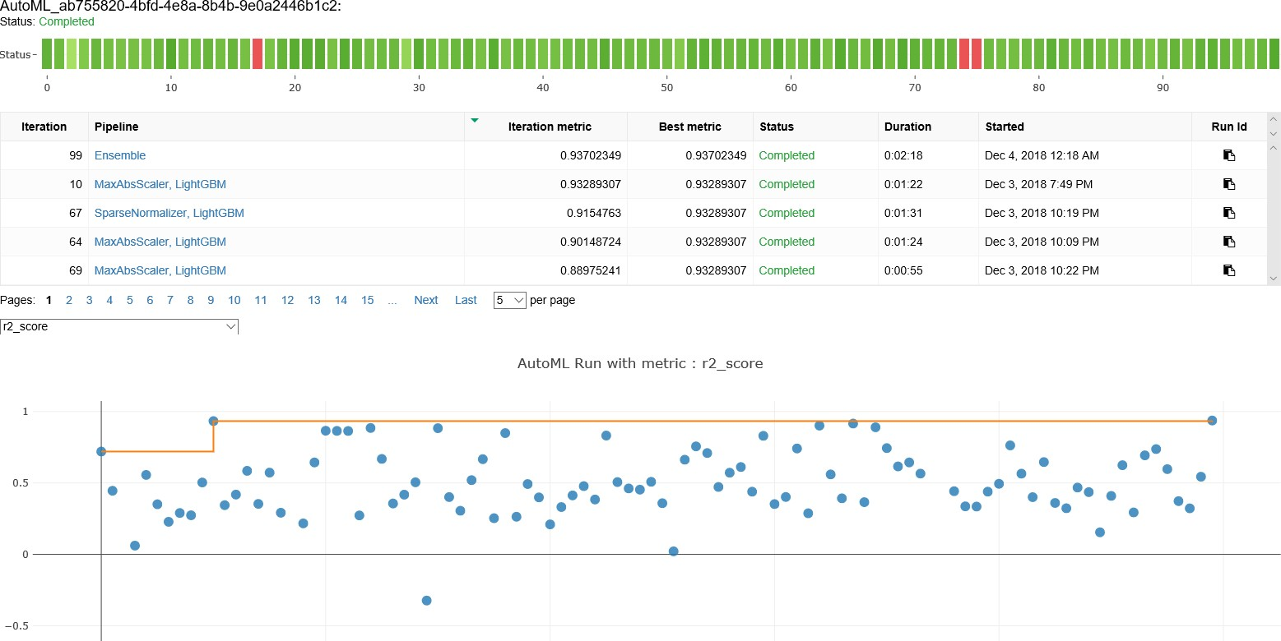

Slide 64
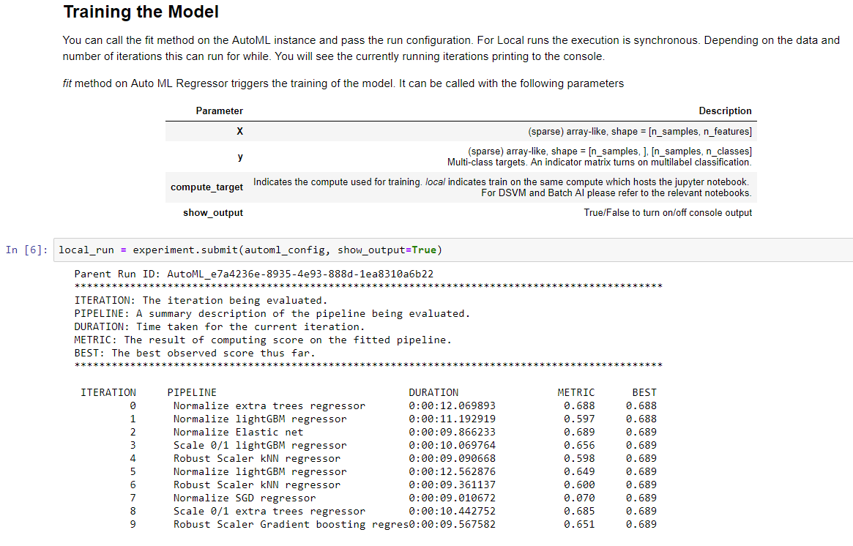
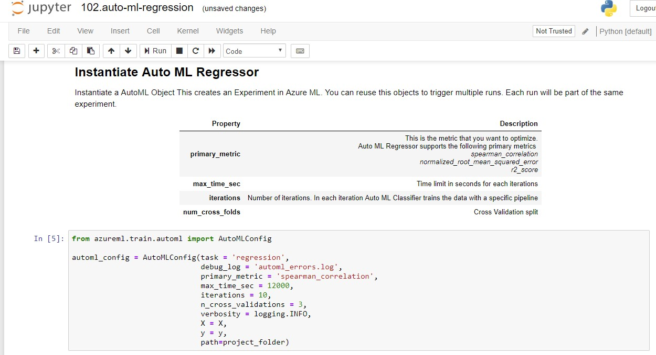
Azure Automated ML
Use via the Python SDK
https://docs.microsoft.com/en-us/python/api/azureml-train-automl/azureml.train.automl.automlexplainer?view=azure-ml-py

Slide 65












Azure Automated ML
Current Capabilities
 | Category | Value
Compute Target

Slide 66



Azure Automated ML
Algorithms Currently Supported
Logistic Regression | Elastic Net | Elastic Net
Stochastic Gradient Descent (SGD) | Light GBM | Light GBM
Naive Bayes | Gradient Boosting | Gradient Boosting
C-Support Vector Classification (SVC) | Decision Tree | Decision Tree
Linear SVC | K Nearest Neighbors | K Nearest Neighbors
K Nearest Neighbors | LARS Lasso | LARS Lasso
Decision Tree | Stochastic Gradient Descent (SGD) | Stochastic Gradient Descent (SGD)
Random Forest | Random Forest | Random Forest
Extremely Randomized Trees | Extremely Randomized Trees | Extremely Randomized Trees
Gradient Boosting
Light GBM

Slide 67
Property | Description | Default Value
task | Specify the type of machine learning problem. Allowed values are Classification Regression Forecasting | None
primary_metric | Metric that you want to optimize in building your model. For example, if you specify accuracy as the primary_metric, automated machine learning looks to find a model with maximum accuracy. You can only specify one primary_metric per experiment. Allowed values are Classification: accuracy AUC_weighted precision_score_weighted balanced_accuracy average_precision_score_weighted Regression: normalized_mean_absolute_error spearman_correlation normalized_root_mean_squared_error normalized_root_mean_squared_log_error R2_score | For Classification: accuracy For Regression: spearman_correlati on
experiment_exit_score | You can set a target value for your primary_metric. Once a model is found that meets the primary_metric target, automated machine learning will stop iterating and the experiment terminates. If this value is not set (default), Automated machine learning experiment will continue to run the number of iterations specified in iterations. Takes a double value. If the target never reaches, then Automated machine learning will continue until it reaches the number of iterations specified in iterations. | None
iterations | Maximum number of iterations. Each iteration is equal to a training job that results in a pipeline. Pipeline is data preprocessing and model. To get a high-quality model, use 250 or more | 100
max_concurrent_iterations | Max number of iterations to run in parallel. This setting works only for remote compute. | 1
max_cores_per_iteration | Indicates how many cores on the compute target would be used to train a single pipeline. If the algorithm can leverage multiple cores, then this increases the performance on a multi-core machine. You can set it to -1 to use all the cores available on the machine. | 1
iteration_timeout_minutes | Limits the amount of time (minutes) a particular iteration takes. If an iteration exceeds the specified amount, that iteration gets canceled. If not set, then the iteration continues to run until it is finished. | None
n_cross_validations | Number of cross validation splits | None
validation_size | Size of validation set as percentage of all training sample. | None
preprocess | True/False True enables experiment to perform preprocessing on the input. Following is a subset of preprocessingMissing Data: Imputes the missing data- Numerical with Average, Text with most occurrence Categorical Values: If data type is numeric and number of unique values is less than 5 percent, Converts into one-hot encoding Etc. for complete list check the GitHub repository Note : if data is sparse you cannot use preprocess = true | False
blacklist_models | Automated machine learning experiment has many different algorithms that it tries. Configure to exclude certain algorithms from the experiment. Useful if you are aware that algorithm(s) do not work well for your dataset. Excluding algorithms can save you compute resources and training time. Allowed values for Classification LogisticRegressionSGDMultinomialNaiveBayesBernoulliNaiveBayesSVMLinearSVMKNNDecisionTreeRandomForestExtremeRandomTreesLightGBMGradientBoostingTensorFlowDNNTensorFlowLinearClassifier Allowed values for Regression ElasticNetGradientBoostingDecisionTreeKNNLassoLarsSGD RandomForestExtremeRandomTreeLightGBMTensorFlowLinearRegressorTensorFlowDNN Allowed values for Forecasting ElasticNetGradientBoostingDecisionTreeKNNLassoLarsSGD RandomForestExtremeRandomTreeLightGBMTensorFlowLinearRegressorTensorFlowDNN | None
whitelist_models | Automated machine learning experiment has many different algorithms that it tries. Configure to include certain algorithms for the experiment. Useful if you are aware that algorithm(s) do work well for your dataset. Allowed values for Classification LogisticRegressionSGDMultinomialNaiveBayesBernoulliNaiveBayesSVMLinearSVMKNNDecisionTreeRandomForestExtremeRandomTreesLightGBMGradientBoostingTensorFlowDNNTensorFlowLinearClassifier Allowed values for Regression ElasticNetGradientBoostingDecisionTreeKNNLassoLarsSGD RandomForestExtremeRandomTreeLightGBMTensorFlowLinearRegressorTensorFlowDNN Allowed values for Forecasting ElasticNetGradientBoostingDecisionTreeKNNLassoLarsSGD RandomForestExtremeRandomTreeLightGBMTensorFlowLinearRegressorTensorFlowDNN | None
verbosity | Controls the level of logging with INFO being the most verbose and CRITICAL being the least. Verbosity level takes the same values as defined in the python logging package. Allowed values are: logging.INFOlogging.WARNINGlogging.ERRORlogging.CRITICAL | logging.INFO
X | All features to train with | None
y | Label data to train with. For classification, should be an array of integers. | None
X_valid | Optional All features to validate with. If not specified, X is split between train and validate | None
y_valid | Optional The label data to validate with. If not specified, y is split between train and validate | None
sample_weight | Optional A weight value for each sample. Use when you would like to assign different weights for your data points | None
sample_weight_valid | Optional A weight value for each validation sample. If not specified, sample_weight is split between train and validate | None
run_configuration | RunConfiguration object. Used for remote runs. | None
data_script | Path to a file containing the get_data method. Required for remote runs. | None
model_explainability | Optional True/False True enables experiment to perform feature importance for every iteration. You can also use explain_model() method on a specific iteration to enable feature importance on-demand for that iteration after experiment is complete. | False
enable_ensembling | Flag to enable an ensembling iteration after all the other iterations complete. | True
ensemble_iterations | Number of iterations during which we choose a fitted pipeline to be part of the final ensemble. | 15
experiment_timeout_minutes | Limits the amount of time (minues) that the whole experiment run can take | None

Slide 68
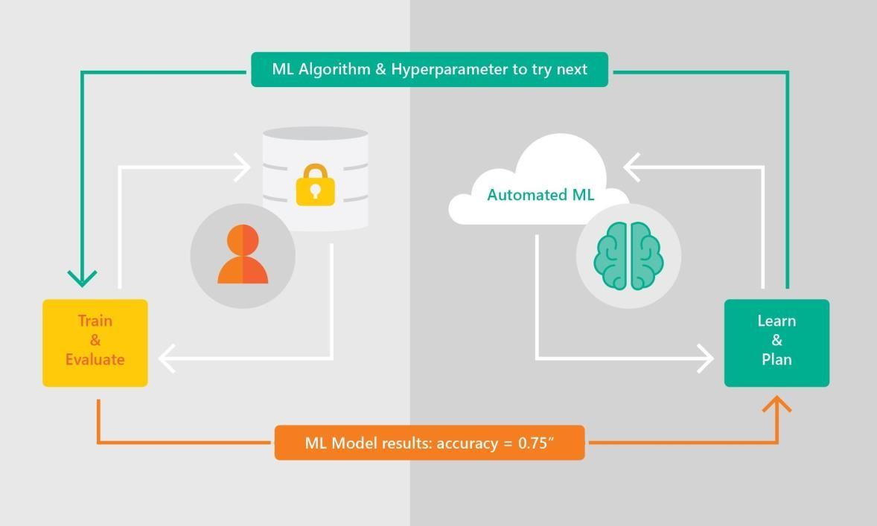
Azure Automated ML
Benefits Overview
Azure Automated ML lets you
Automate the exploration process Use resources more efficiently Optimize model for desired outcome Control resource budget
Apply it to different models and learning domains
Pick training frameworks of choice
Visualize all configurations in one place
Note about security: on the right side of the automated ML service, the gray part is separated from the training and data, only the result (orange bottom block) is sent back from training to the service; hence your data and algorithm safely stay within your subscription.

Slide 69
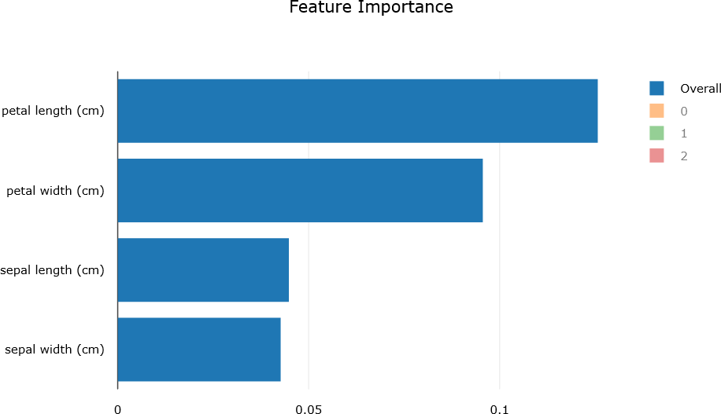
Azure Automated ML
Model Explainability
automl_config = AutoMLConfig(task = 'classification',
debug_log = 'automl_errors.log', primary_metric = 'AUC_weighted', max_time_sec = 12000,
iterations = 10,
verbosity = logging.INFO, X = X_train,
y = y_train, X_valid = X_test, y_valid = y_test,
model_explainability=True,
path=project_folder)
You can view it in your workspace in Azure portal
Or you can show it using Jupyter widgets in a notebook:
from azureml.widgets import RunDetails RunDetails(local_run).show()
from azureml.train.automl.automlexplainer import retrieve_model_explanation shap_values, expected_values, overall_summary, overall_imp, per_class_summary, per_class_imp = \ retrieve_model_explanation(best_run) #Overall feature importance print(overall_imp) print(overall_summary) #Class-level feature importance print(per_class_imp) print(per_class_summary)

Slide 70
Microsoft Research Paper & Examples
For those who wants to find out more about Automated Machine Learning:
https://arxiv.org/abs/1705.05355
https://github.com/Azure/MachineLearningNotebooks/tree/master/ how-to-use-azureml/automated-machine-learning

Slide 71
Distributed Training with Azure ML Compute

Slide 72









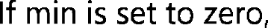
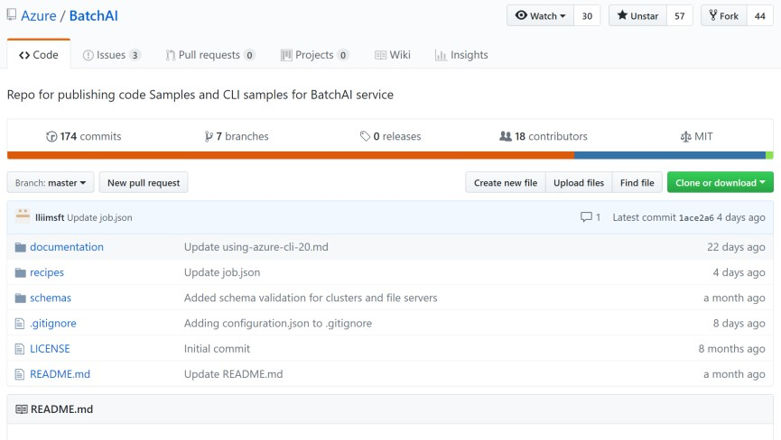
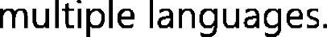


Distributed Training with Azure ML Compute
distributed training with Horovod

Slide 73

Try it for free!
http://aka.ms/amlfree
THANK YOU!
Learn more:
https://docs.microsoft.com/en-us/azure/machine-learning/service/
Visit the Getting started guide:
https://docs.microsoft.com/en-us/azure/machine-learning/service/quickstart-
create-workspace-with-python
Fantastic free Azure notebooks (with Azure Machine Learning SDK pre-configured): https://notebooks.azure.com

